Slide 1
VIETNAM NATIONAL UNIVERSITY HO CHI MINH CITY
UNIVERSITY OF INFORMATION TECHNOLOGY • FACULTY OF COMPUTER SCIENCE
FINANCIAL FRAUD DETECTION
Applied Machine Learning & Deep Learning on PaySim Synthetic Dataset
Course: CS106 — Artificial Intelligence | Advisor: Assoc. Prof. Nguyen Dinh Hien
TEAM 09
Tran Hoang Hon (26410046) • Dang Chi Thanh (25730067) • Nguyen Duy Khang (26410055)
Hoang Cao Son (25730061) • Vu Van Duy (26410031) • Bui Thi My Cam (25730013) • Pham Thanh Trung (26410141)
Ho Chi Minh City, September 2026

Slide 2
UIT • VNU-HCM | CS106: ARTIFICIAL INTELLIGENCE
AGENDA & ROADMAP
01
Introduction & Problem Formulation
Financial context, extreme class imbalance, and formal task formulation.
02
Exploratory Data Analysis & Feature Engineering
Category confinement, balance drain signatures, and 14 synthesized features.
03
Proposed Methodologies & Machine Learning Pipeline
Resampling (SMOTE/ADASYN), Random Forest, XGBoost, and Deep Autoencoder.
04
Experiments, Results & Comparative Evaluation
Benchmark metrics, confusion matrices, feature gains, and error trade-offs.
05
Interactive System & Future Research Trajectories
Streamlit real-time dashboard, business viability, limitations, and GNN roadmap.
CS106: Artificial Intelligence — Team 09 — Final Project: Financial Fraud Detection
2 / 24

Slide 3
UNIVERSITY OF INFORMATION TECHNOLOGY, VNU-HCM • CS106 FINAL DEFENSE
PART 01
INTRODUCTION & PROBLEM FORMULATION
Industrial Background & Mobile Money Expansion
The Asymmetric Cost & Extreme Imbalance Paradox
Formal AI Problem Statement & Research Objectives

Slide 4
UIT • VNU-HCM | CS106 (AI)
1. Introduction
2. EDA & Features
3. Methodology
4. Evaluation
5. Demo & Future
Problem Motivation & Technical Challenges
1. Industrial Context & Scale
• Mobile money transactions have surged globally, introducing complex synthetic fraud vectors.
• Real-time defense mechanisms require sub-100ms inference latency before funds leave the system.
2. Extreme Class Imbalance (~0.13%)
• Fraud accounts for only ~1 out of every 800 transactions in the PaySim universe.
• Cost Asymmetry: False Negatives (missed fraud) lead to direct capital loss, while False Positives cause customer friction.
3. Non-Stationary Fraud Patterns
• Adversaries constantly morph account routing tactics to evade static rule-based threshold filters.
Class Target | Y in {0, 1} | 1 = Fraudulent, 0 = Legitimate
Imbalance | IR = 0.13% | 1,643 frauds per 1.3M events
Primary Goal | Max PR-AUC | Maximize rare fraud recall
Loss Asymmetry | C_FN >> C_FP | Cost penalty ratio is critical
Research Objectives
Construct an end-to-end, leak-free ML pipeline.
Formulate domain feature equations capturing ledger state discrepancies.
Benchmark Ensemble Trees against Deep Unsupervised Anomaly Detection.
Deploy interactive real-time decision dashboard.
CS106: Artificial Intelligence — Team 09 — Final Project: Financial Fraud Detection
4 / 24

Slide 5
UIT • VNU-HCM | CS106 (AI)
1. Introduction
2. EDA & Features
3. Methodology
4. Evaluation
5. Demo & Future
PaySim Dataset: Statistical Characteristics
6,362,620 -> 200,000
8,213
11 -> 14 Features
Dataset Scaling
Stratified downsampling preserving 100% fraud
Positive Instances (isFraud = 1)
Ground-truth fraud transactions
Synthesized Feature Space
Expanded with balance delta equations
Feature Name | Data Type | Domain Description & Operational Role
step | Integer | Time step unit in hours (1..744, representing 30 simulation days)
type | Categorical | Transaction category: CASH_OUT, TRANSFER, PAYMENT, CASH_IN, DEBIT
amount | Continuous | Transaction amount in local currency units
oldbalanceOrg / newbalanceOrig | Continuous | Initial balance and post-transaction balance of the sender account
oldbalanceDest / newbalanceDest | Continuous | Initial balance and post-transaction balance of the recipient account
CS106: Artificial Intelligence — Team 09 — Final Project: Financial Fraud Detection
5 / 24

Slide 6
UNIVERSITY OF INFORMATION TECHNOLOGY, VNU-HCM • CS106 FINAL DEFENSE
PART 02
EXPLORATORY DATA ANALYSIS & FEATURE ENGINEERING
Empirical Behavioral Signatures in Financial Fraud
Mathematical Formulation of 14 Engineered Features
Handling Class Imbalance: SMOTE vs. ADASYN Formulation

Slide 7
UIT • VNU-HCM | CS106 (AI)
1. Introduction
2. EDA & Features
3. Methodology
4. Evaluation
5. Demo & Future
Exploratory Data Analysis: Key Behavioral Signatures
Finding 1: Category Confinement
Finding 2: Total Account Drain
Finding 3: Destination Ledger Mismatch
100% FRAUD CONCENTRATION
97.56% OF FRAUD CASES
ZERO DELTA ANOMALY
• 100% of all fraudulent instances occur strictly in TRANSFER and CASH_OUT.
• All PAYMENT, CASH_IN, and DEBIT instances have 0% fraud.
• Pipeline Action: Filter dataset to only TRANSFER & CASH_OUT to eliminate 70% irrelevant noise.
• In 97.56% of fraudulent transfers, the victim account is completely drained (newbalanceOrig == 0).
• Perpetrators maximize cash-out efficiency before identity flags trigger.
• Key Signal: Account drain ratio serves as primary discriminator.
• A massive proportion of fraudulent transactions show no increase in destination account balances.
• Suggests mule accounts or instant multi-hop laundering routing.
• Key Signal: Destination discrepancy error highlights illegal extraction.
CS106: Artificial Intelligence — Team 09 — Final Project: Financial Fraud Detection
7 / 24

Slide 8
UIT • VNU-HCM | CS106 (AI)
1. Introduction
2. EDA & Features
3. Methodology
4. Evaluation
5. Demo & Future
Feature Engineering: 14 Synthesized Domain Predictors
1. Origin Balance Error (Delta Orig)
Feature Space | d = 14 | Expanded numeric domain representation
Origin Error | Err_orig | Captures ledger imbalance (49.9% gain)
Dest Error | Err_dest | Tracks routing discrepancies
Amount Ratio | R_amt | amount / (oldbalanceOrg + 1)
Hour of Day | h in [0..23] | step % 24 (diurnal temporal cycle)
Overnight Flag | I_night | 1 if hour in [0..5] (overnight attacks)
$Δ_{\text{orig}}=\text{oldbalanceOrg}−\text{amount}−\text{newbalanceOrig}$
Measures discrepancy between expected and reported sender balance post-transaction.
2. Destination Balance Error (Delta Dest)
$Δ_{\text{dest}}=\text{oldbalanceDest}+\text{amount}−\text{newbalanceDest}$
Tracks uncredited or routing discrepancies at receiving destination accounts.
Feature Importance Deductions
Engineered ledger errors contribute over 97% of tree split gains.
Temporal cyclicity (hour) isolates automated scripted nighttime attacks.
All features are scaled strictly on training split to prevent leakage.
3. Full Account Drain Indicator
$I_{\text{drain}}=I(\text{oldbalanceOrg}>0∧\text{newbalanceOrig}=0)$
Binary indicator capturing single-step complete account exhaustion.
CS106: Artificial Intelligence — Team 09 — Final Project: Financial Fraud Detection
8 / 24

Slide 9
UIT • VNU-HCM | CS106 (AI)
1. Introduction
2. EDA & Features
3. Methodology
4. Evaluation
5. Demo & Future
Class Imbalance Mitigation: SMOTE vs. ADASYN
The Accuracy Paradox in Imbalanced AI
ADASYN Density-Weighted Resampling
• A naive "All Normal" classifier achieves 99.87% Accuracy yet misses 100% of fraud attacks.
• Evaluation Mandate: Model selection must be strictly governed by Precision, Recall, F1-Score, and PR-AUC.
$r_{i}=Δ_{i}/K, Γ_{i}=r_{i}/\sum_{j=1}^{m}{r_{j}}$
Generates synthetic minority instances proportionally to Gamma_i near difficult decision boundaries.
SMOTE Interpolation Formulation
$x_{\text{new}}=x_{i}+λ(x_{zi}−x_{i}), λ∼U(0,1)$
Empirical Takeaway for Fraud Detection
Synthesizes artificial minority instances along vector line segments connecting k-nearest minority neighbors in latent space.
SMOTE produces cleaner synthetic boundaries with lower False Positives.
ADASYN over-synthesizes in high-noise boundary overlap regions, slightly degrading Precision.
CS106: Artificial Intelligence — Team 09 — Final Project: Financial Fraud Detection
9 / 24

Slide 10
UNIVERSITY OF INFORMATION TECHNOLOGY, VNU-HCM • CS106 FINAL DEFENSE
PART 03
PROPOSED METHODOLOGIES & PIPELINE
Leak-Free End-to-End System Pipeline Architecture
Supervised Learning: Random Forest (Bagging & MDI Importance)
Gradient Boosting: XGBoost (Regularized GBDT & Taylor Expansion)
Unsupervised Learning: Deep Autoencoder (Manifold Reconstruction)

Slide 11
UIT • VNU-HCM | CS106 (AI)
1. Introduction
2. EDA & Features
3. Methodology
4. Evaluation
5. Demo & Future
End-to-End Leak-Free Machine Learning Pipeline
1
2
3
4
5
6
Filtering
Feature Eng.
Stratified Split
Resampling
Training
Evaluation
Retain TRANSFER & CASH_OUT
Compute 14 mathematical features
80/20 Train/Test separation
SMOTE / ADASYN on Train only
Fit RF, XGBoost & Autoencoder
Test set inference (N=40,000)
Strict Protocol Against Data Leakage
Oversampling (SMOTE/ADASYN) is strictly executed AFTER data partitioning on training fold only.
StandardScaler normalization is fitted on the training split only and applied blindly to the test set.
Zero test target information is leaked into model feature representations or hyperparameter selection.
CS106: Artificial Intelligence — Team 09 — Final Project: Financial Fraud Detection
11 / 24

Slide 12
UIT • VNU-HCM | CS106 (AI)
1. Introduction
2. EDA & Features
3. Methodology
4. Evaluation
5. Demo & Future
Supervised Architecture 1: Random Forest Ensemble
Ensemble Bagging Architecture:
• Constructs an ensemble of B decorrelated Decision Trees trained on bootstrap sub-samples.
• Reduces variance without inflating bias, demonstrating high resilience against feature co-linearity.
• Provides Gini Impurity-based Mean Decrease in Impurity (MDI) feature ranking.
Optimal Hyperparameter Configuration:
• n_estimators: 200 (SMOTE) / 500 (ADASYN)
• max_depth: 20 | min_samples_split: 2 | max_features: "sqrt" | class_weight: "balanced"
Ensemble Size | B = 200 / 500 | Number of bagged trees
Depth Limit | d_max = 20 | Prevents tree overfitting
Split Metric | Gini Impurity | Information impurity criterion
Feature Subset | m = sqrt(d) ~ 4 | Random subspace dimension
Architectural Strengths
Peak Precision: Generates only 1 False Positive across 38,357 test transactions.
High Interpretability: Transparent decision paths and feature impurity scoring.
Limitation: High computational training time (~1187s).
Gini Impurity & MDI Split Criterion
G(p)=1−k=1Cpk2, ΔG=Gparent−c​NcNGc
Each split optimizes the reduction in Gini impurity across randomly selected feature subspaces.
CS106: Artificial Intelligence — Team 09 — Final Project: Financial Fraud Detection
12 / 24

Slide 13
UIT • VNU-HCM | CS106 (AI)
1. Introduction
2. EDA & Features
3. Methodology
4. Evaluation
5. Demo & Future
Supervised Architecture 2: XGBoost Classifier
Gradient Boosted Decision Trees (GBDT):
• Minimizes a regularized objective function using second-order Taylor expansion.
• Incorporates explicit L1/L2 leaf regularization to prevent over-complex structures.
• High Throughput: Trains in ~41.6s (28.5x faster than Random Forest ~1187s).
Tuned Hyperparameter Setup:
• learning_rate (eta): 0.2 | n_estimators: 300 | max_depth: 8
• subsample: 0.85 | colsample_bytree: 1.0 | eval_metric: "logloss"
Objective | Loss + Omega(f) | Regularized loss formulation
Shrinkage | eta = 0.2 | Step size scaling factor
Max Depth | d = 8 | Max tree depth per boosting round
Subsample | rho = 0.85 | Stochastic row sampling fraction
Production Advantages
Near-identical F1-score (99.63%) compared to Random Forest (99.73%).
Extremely low latency: < 0.5ms single-sample inference time.
Ideal for live financial transaction gateway screening.
Regularized Objective Function (2nd-Order Taylor)
$L^{(t)}≈\sum_{i=1}^{n}{[}g_{i}f_{t}(x_{i})+\frac{1}{2}h_{i}f_{t}^{2}(x_{i})]+γT+\frac{1}{2}λ\sum_{j=1}^{T}{w_{j}^{2}}$
where g_i and h_i are 1st and 2nd order gradients of the loss function with respect to previous predictions.
CS106: Artificial Intelligence — Team 09 — Final Project: Financial Fraud Detection
13 / 24

Slide 14
UIT • VNU-HCM | CS106 (AI)
1. Introduction
2. EDA & Features
3. Methodology
4. Evaluation
5. Demo & Future
Unsupervised Architecture 3: Deep Autoencoder
One-Class Semi-Supervised Anomaly Detection:
• Network is trained EXCLUSIVELY on legitimate transactions (N = 122,744 normal samples).
• Learns a low-dimensional manifold encoding normal transaction behavior.
• Anomaly Scoring: Fraudulent instances fail reconstruction -> Yield high Reconstruction Error.
Architectural Specifications:
• Symmetric Topology: 16 -> 8 -> 4 (Bottleneck) -> 8 -> 16
• Optimizer: Adam (lr=1e-3) | Loss: MSE | Threshold: tau = 0.045456 (95th percentile)
Bottleneck | z in R^4 | Latent embedding representation
Loss Function | MSE(x, x_hat) | Mean squared reconstruction error
Activation | ReLU / Linear | Non-linear hidden layer mappings
Threshold | tau = 0.0455 | 95th percentile validation cutoff
Zero-Day Detection Role
Achieves 75.23% Recall without observing any fraud labels during training.
Acts as a complementary defense layer for novel, unseen attack signatures.
Reconstruction Loss & Decision Cutoff
$L_{\text{MSE}}(x,\hat{x})=\frac{1}{d}\sum_{j=1}^{d}{(}x_{j}−{\hat{x}}_{j})^{2}, \hat{y}=I(L_{\text{MSE}}>τ)$
Samples with MSE exceeding the validation 95th percentile threshold tau are classified as anomalous.
CS106: Artificial Intelligence — Team 09 — Final Project: Financial Fraud Detection
14 / 24

Slide 15
UNIVERSITY OF INFORMATION TECHNOLOGY, VNU-HCM • CS106 FINAL DEFENSE
PART 04
EXPERIMENTS, RESULTS & COMPARATIVE EVALUATION
Comprehensive Performance Benchmark (Precision, Recall, F1, AUC)
Confusion Matrix & False Alarm vs. Missed Fraud Trade-offs
Feature Importance Attribution & Gain Contributions
Autoencoder Anomaly Thresholding & Reconstruction Dynamics

Slide 16
UIT • VNU-HCM | CS106 (AI)
1. Introduction
2. EDA & Features
3. Methodology
4. Evaluation
5. Demo & Future
Experimental Results: Benchmark Comparison (N = 40,000)
Model Architecture | Resampling | Precision | Recall | F1-Score | ROC-AUC | Train Time
Random Forest | SMOTE | 0.9994 | 0.9951 | 0.9973 (Best) | 0.9994 | 1187.7s
Random Forest | ADASYN | 0.9982 | 0.9951 | 0.9966 | 0.9992 | 1167.5s
XGBoost | SMOTE | 0.9976 | 0.9951 | 0.9963 | 0.9993 | 41.6s
XGBoost | ADASYN | 0.9957 | 0.9951 | 0.9954 | 0.9994 | 41.5s
Autoencoder | None (One-Class) | 0.3822 | 0.7523 | 0.5069 | 0.9318 | 215.3s
Key Empirical Deductions
RF + SMOTE achieves peak F1-Score (99.73%) with only 1 False Positive across 38,357 legitimate test samples.
XGBoost achieves near-identical classification performance (F1 99.63%) with 28.5x computational speedup.
Autoencoder detects 75.23% of fraud cases in an entirely unsupervised setting without seeing fraud labels.
CS106: Artificial Intelligence — Team 09 — Final Project: Financial Fraud Detection
16 / 24

Slide 17
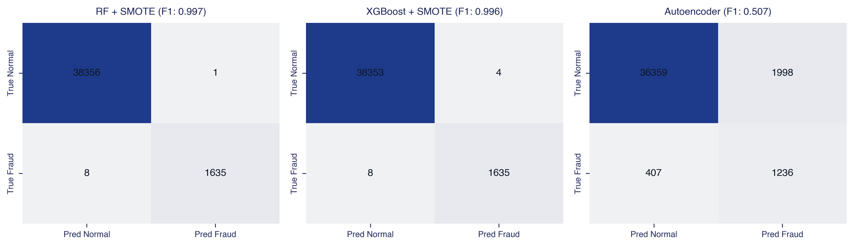
UIT • VNU-HCM | CS106 (AI)
1. Introduction
2. EDA & Features
3. Methodology
4. Evaluation
5. Demo & Future
Confusion Matrix & Error Distribution Analysis
False Negative & False Positive Trade-off Analysis
Both Random Forest and XGBoost miss only 8 fraud instances out of 1,643 true fraud cases (Recall = 99.51%).
RF-SMOTE generates only 1 False Alarm (FP=1), whereas Autoencoder generates 1,998 FP due to unsupervised 95% cutoff.
CS106: Artificial Intelligence — Team 09 — Final Project: Financial Fraud Detection
17 / 24

Slide 18
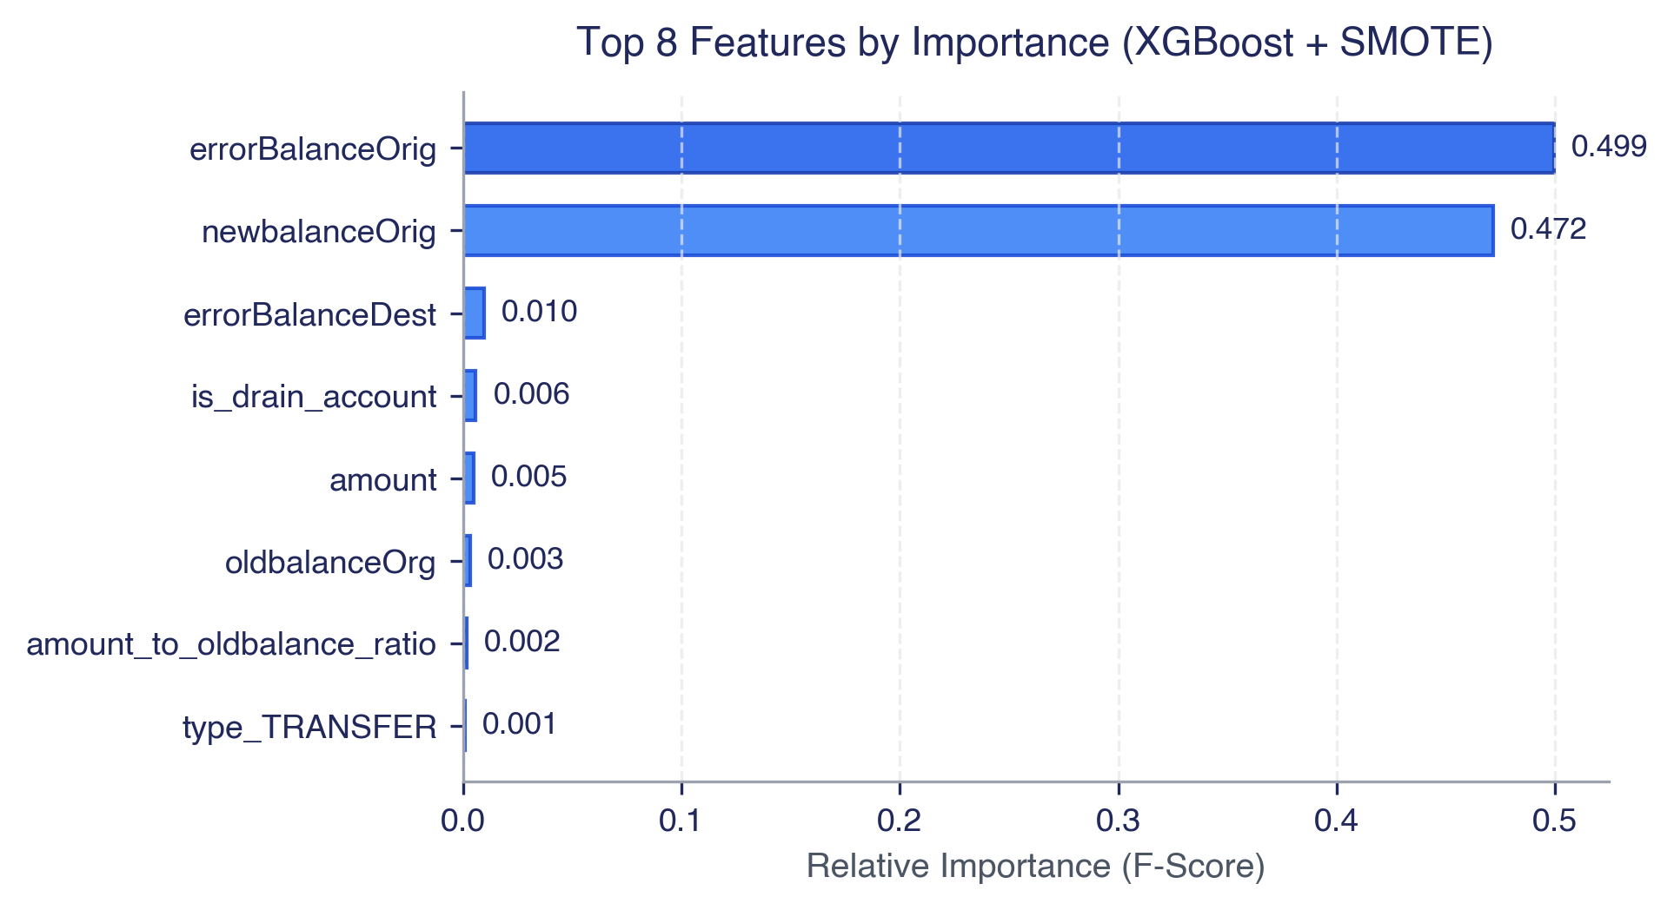
UIT • VNU-HCM | CS106 (AI)
1. Introduction
2. EDA & Features
3. Methodology
4. Evaluation
5. Demo & Future
Feature Importance: XGBoost Decision Split Gains
Insights from XGBoost Feature Gain:
• errorBalanceOrig accounts for ~49.9% of model decision splits.
• newbalanceOrig provides ~47.2% additional predictive power.
• Combined Impact: Engineered ledger discrepancies capture over 97% of overall fraud dynamics, proving the critical efficacy of domain feature engineering.
Key Feature Insights
Top 2 features contribute > 97% of total tree split decisions.
Raw balance amounts without discrepancy deltas have low predictive power.
CS106: Artificial Intelligence — Team 09 — Final Project: Financial Fraud Detection
18 / 24

Slide 19
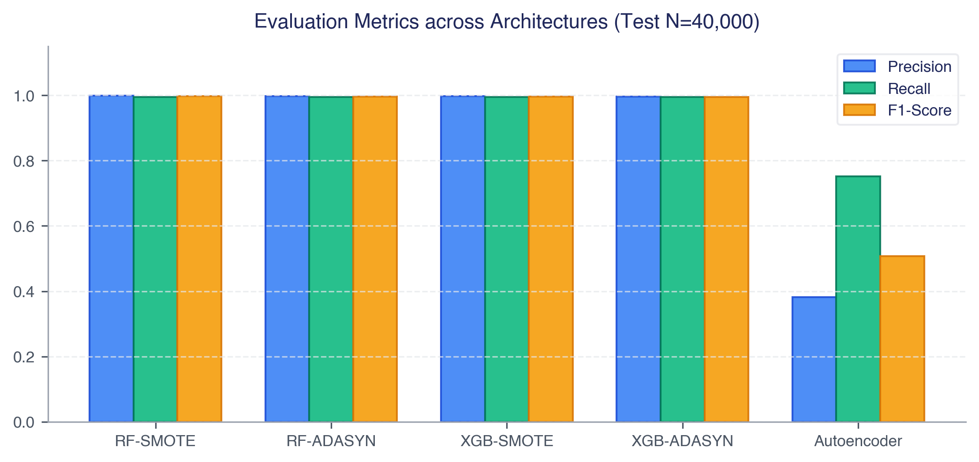
UIT • VNU-HCM | CS106 (AI)
1. Introduction
2. EDA & Features
3. Methodology
4. Evaluation
5. Demo & Future
Comparative Evaluation: Precision, Recall & F1-Score
Resampling Performance Analysis:
• SMOTE consistently outperforms ADASYN across all decision tree architectures.
• ADASYN synthesizes excess noise instances in boundary overlap zones, slightly increasing False Positives.
• Recommendation: Deploy XGBoost + SMOTE for optimal inference throughput and fraud detection precision in live production environments.
Benchmarking Synthesis
SMOTE achieves superior boundary separation over ADASYN.
Supervised methods strongly dominate unsupervised reconstruction in known fraud types.
CS106: Artificial Intelligence — Team 09 — Final Project: Financial Fraud Detection
19 / 24

Slide 20
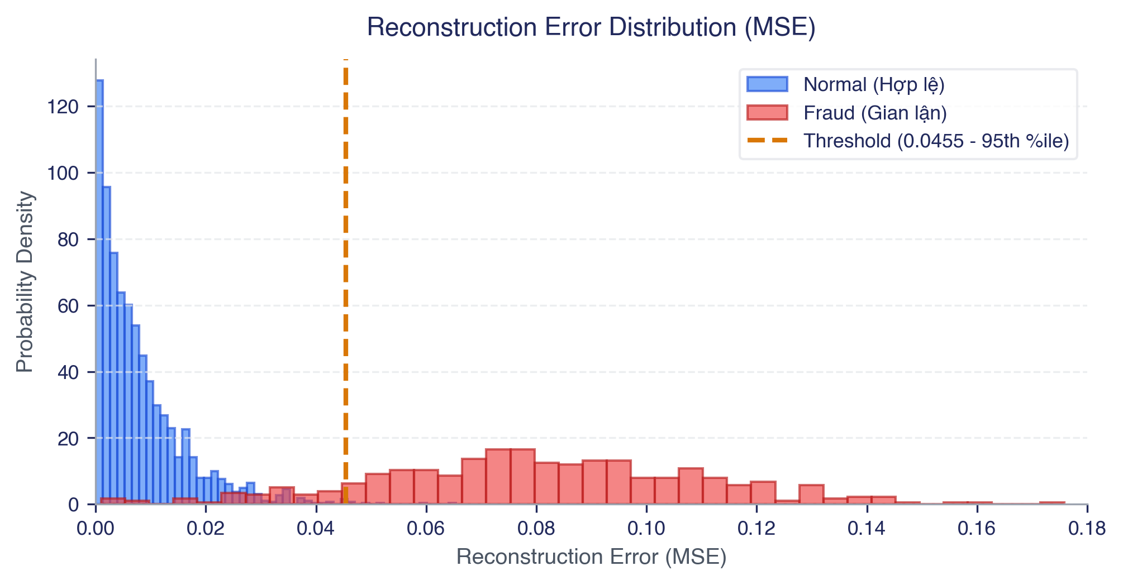
UIT • VNU-HCM | CS106 (AI)
1. Introduction
2. EDA & Features
3. Methodology
4. Evaluation
5. Demo & Future
Autoencoder Anomaly Thresholding & Decision Boundary
Threshold Sweep Dynamics:
• 95th Percentile (tau = 0.0455):
Balances Recall (75.2%) with Precision (38.2%).
• 99.9th Percentile (tau = 0.7460):
Precision jumps to 91.5% but Recall drops to 25.4%.
• Operational Role: Excellent as a secondary zero-day defense layer for unlabelled novel fraud patterns.
Threshold Calibration
Tau = 0.0455 (95th percentile) optimizes the F1-Score trade-off curve.
Unsupervised model successfully flags 1,236 true fraud events.
CS106: Artificial Intelligence — Team 09 — Final Project: Financial Fraud Detection
20 / 24

Slide 21
UNIVERSITY OF INFORMATION TECHNOLOGY, VNU-HCM • CS106 FINAL DEFENSE
PART 05
INTERACTIVE SYSTEM & FUTURE ROADMAP
Streamlit Real-Time Inference Dashboard Architecture
Summary of Key Academic & Engineering Contributions
Research Limitations & Graph Neural Network (GNN) Roadmap

Slide 22
UIT • VNU-HCM | CS106 (AI)
1. Introduction
2. EDA & Features
3. Methodology
4. Evaluation
5. Demo & Future
Interactive Demonstration: Streamlit Real-Time Dashboard
Real-Time Inference Architecture
Demonstrated Simulation Scenarios
Lightweight Streamlit UI with dynamic risk probability gauges and visual status cards.
Instant feature extraction engine transforming raw user inputs into the 14-dimension engineered vector.
Pre-loaded serialized XGBoost and Random Forest pipelines via Joblib.
Sub-millisecond single-transaction inference latency (< 1ms).
Scenario 1 (Normal Transfer): Standard transaction with valid balances -> Model Output: SAFE (Risk Probability < 0.1%).
Scenario 2 (Account Drain): High-amount transfer leaving zero origin balance -> Model Output: HIGH RISK FRAUD (Risk Probability > 99.8%).
Batch CSV Scoring: Allows bulk processing and compliance report exports.
CS106: Artificial Intelligence — Team 09 — Final Project: Financial Fraud Detection
22 / 24

Slide 23
UIT • VNU-HCM | CS106 (AI)
1. Introduction
2. EDA & Features
3. Methodology
4. Evaluation
5. Demo & Future
Summary of Contributions & Future Research
Key Project Contributions
Future Research Roadmap
Leak-Free Protocol: 80/20 stratified partition preventing synthetic data contamination.
Domain Engineering: 14 synthesized features capturing > 97% of tree split gains.
Superior Benchmark: F1-Score = 99.73% and Recall = 99.51% (missing only 8 out of 1,643 frauds).
Operational Deployment: Ready-to-use Streamlit dashboard for real-time risk screening.
Graph Neural Networks (GNN): Deploy GCN / GraphSAGE to uncover structured money-laundering subgraphs.
Streaming Ingestion: Integrate Apache Kafka / Flink for distributed sub-second streaming transactions.
Explainable AI (XAI): Integrate SHAP / TreeExplainer for regulatory compliant transaction audit logs.
CS106: Artificial Intelligence — Team 09 — Final Project: Financial Fraud Detection
23 / 24

Slide 24
THANK YOU FOR YOUR ATTENTION!
CS106: ARTIFICIAL INTELLIGENCE • FINAL PROJECT DEFENSE • TEAM 09
KEY ACADEMIC REFERENCES & PROJECT REPOSITORY
[1] E. A. Lopez-Rojas, A. Elmir, S. Axelsson. "PaySim: A Financial Mobile Money Simulator for Fraud Detection", 28th EMSS, 2016.
[2] T. Chen, C. Guestrin. "XGBoost: A Scalable Tree Boosting System", Proc. 22nd ACM SIGKDD, 2016.
[3] N. V. Chawla, K. W. Bowyer, L. O. Hall, W. P. Kegelmeyer. "SMOTE: Synthetic Minority Over-sampling Technique", JAIR, 2002.
[4] L. Breiman. "Random Forests", Machine Learning, 45(1), pp. 5-32, 2001.
[5] Project Submodule: https://github.com/uit-25730067-chithanh/CS106-Team09-Fraud-Detection
We cordially welcome all questions, feedback, and discussions from the Committee.

